Slide 1
BOOSTING
ADABOOST
XGBOOST
BY: Muhammad Rafeh

Slide 2
Boosting
Boosting is a technique used in machine learning to improve the performance of models. It helps turn a model that makes a lot of mistakes (high bias) into one that makes fewer mistakes and is more accurate (low bias and low variance).
How it works:
We start with a dataset and pass it to the first model.
The model makes predictions, but it also makes some mistakes (errors).
These errors are noted, and we pass them along with the original data to the second model.
The second model focuses more on the mistakes made by the first model and tries to correct them.
This process is repeated for several models. Each new model tries to fix the errors made by the previous ones.
We give each model a weight (called alpha). Models that make fewer mistakes get higher weights.
Finally, all the models are combined (added together) to make the final prediction.
By combining many weak models (which aren't very accurate individually), boosting creates one strong model that performs much better.

Slide 3
Adaboost
AdaBoost is a boosting technique that works in a stage-wise additive manner. This means it adds multiple weak learners one by one, and each new model focuses on the errors made by the previous ones.
Key Points to Understand in AdaBoost:
Weak Learners:
These are models that perform just slightly better than random guessing — in other words, they have accuracy less than or around 50%. In AdaBoost, many such weak models are combined to create a strong one.
+1 and -1 Labels:
In binary classification (yes/no problems), we usually use 0 for negative and 1 for positive. But in AdaBoost, the labels are changed to +1 for positive and -1 for negative. This helps with the math behind the algorithm.
Decision Stump:
The weak learner used in AdaBoost is often a decision stump, which is a simple decision tree with depth = 1 (i.e., it makes decisions based on just one feature).

Slide 4
Example: We have x1(cgpa) x2(iq level) y(placment) create an adaboost algorithm to identify weather student will be placed or not.
Initial weight α = 1.02, apply to each row
x₁ x₂ y y_pred weight update weight
3 7 1 1 0.2 0.16
2 9 0 1 ✕ 0.2 0.24
1 4 1 0 ✕ 0.2 0.24
9 8 0 0 0.2 0.16
3 7 0 0 0.2 0.16
Sum = 0.96

Slide 5
TO FIND ALPHA = 1/2ln(1-error/error)
error= add all wieghts where you get wrong prediction by comparing y_pred and y column
error= 0.2+0.2=0.4
alpha= 1/2ln(1-0.4/0.4)=0.20
now we have to send data to next model and also tell model to focus upon errors for doing this we will perform upsampling.(increasing the weights) How much weights to increase?
For misclassified points/wrong predictions:
new_wt=cur_wt*e^alpha1
For classified points/correct predictions:
new_wt=cur_wt*e^(-alpha1)

Slide 6
now we have to make sure that some of all the weights(alpha) is 1 if not then make another column and divide individual weight by the sum of weights
UP SAMPLING:
now find ranges:
x₁ x₂ y new weight range
3 7 1 0.16 0 - 0.16
2 9 0 0.24 0.16 - 0.4
1 4 1 0.24 0.4 - 0.666
9 8 0 0.16 0.666 - 0.832
3 7 0 0.16 0.832 - 1

Slide 7
Take 5 random number (these numbers depend upon number of rows uin data) between 0 and 1
0.8,0.13,0.43,0.62,0.50
now check number of rows in which these numbers fall between the range
4 ,1 ,3 ,3 ,3
now only send rows with these numbers to the next model
x₁ x₂ y new wt
3 7 1 0.16
1 4 0 0.25
1 4 1 0.25
1 4 0 0.25
3 7 0 0.16
Send this dataset, repeat all process again. (α at the end gets added)
sign(alpha(h1x)+alpha2(h2x)+.....+aplhan(hnx)
if result is positive then student will be placed
else not placed.

Slide 8
Python Code:
from sklearn.ensemble import AdaBoostClassifier
from sklearn.tree import DecisionTreeClassifier
import numpy as np
# Data
X = np.array([
[3, 7],
[2, 9],
[1, 4],
[9, 8],
[3, 7]
])

Slide 9
y = np.array([1, 0, 1, 0, 0])
# Base model
base_model = DecisionTreeClassifier(max_depth=1)
# AdaBoost (for sklearn >= 1.2)
model = AdaBoostClassifier(estimator=base_model, n_estimators=10, learning_rate=0.3)
model.fit(X, y)
# Predict
prediction = model.predict([[3, 7]])
print("Predicted Placement:", prediction[0])

Slide 10
XGboost:
XGBoost (Extreme Gradient Boosting)
XGBoost is an improved version of the gradient boosting algorithm. It uses all the core ideas of gradient boosting but adds extra techniques to make it faster, more powerful, and more efficient.
Why XGBoost Was Created:
Older machine learning models like:
Random Forest (RF),
Support Vector Machines (SVM), and
Gradient Boosting,
had problems with:
Scalability (hard to work with large datasets),
Performance (slow or not very accurate).

Slide 11
To solve these problems, XGBoost was introduced. It was designed to be:
Main Features of XGBoost:
High Performance:
Gives very accurate results, often winning machine learning competitions.
Speed:
Trains faster by using optimized techniques like parallel processing and efficient memory use.
Flexibility:
Supports various objectives (like regression, classification, ranking) and can work with missing data.

Slide 12
XG boost-regresion
GPA Package Mean(pakcage) Residual (P - M)
6.7 4.5 7.3 -2.8
9.0 11 7.3 3.7
7.5 6 7.3 -1.3
5.0 8 7.3 0.7
1st step: Find mean and then there is an error for each point.
Now pass GPA & residual column to form decision tree.

Slide 13
Creating Decision Tree
Before: Find the leaf node(s) = -2.8,3.7,-1.3,0.7
Similarity Score (SS)=sum_of_residual)^2/# of residual+lambda (lambda=0)
= 0.02
now sort cgpa and split based on there avg
5.0 splits will be 5.0+6.7/2=5.85
6.7 6.7+7.5/2=7.1
7.5 7.5+9.0/2=8.25
9.0

Slide 14
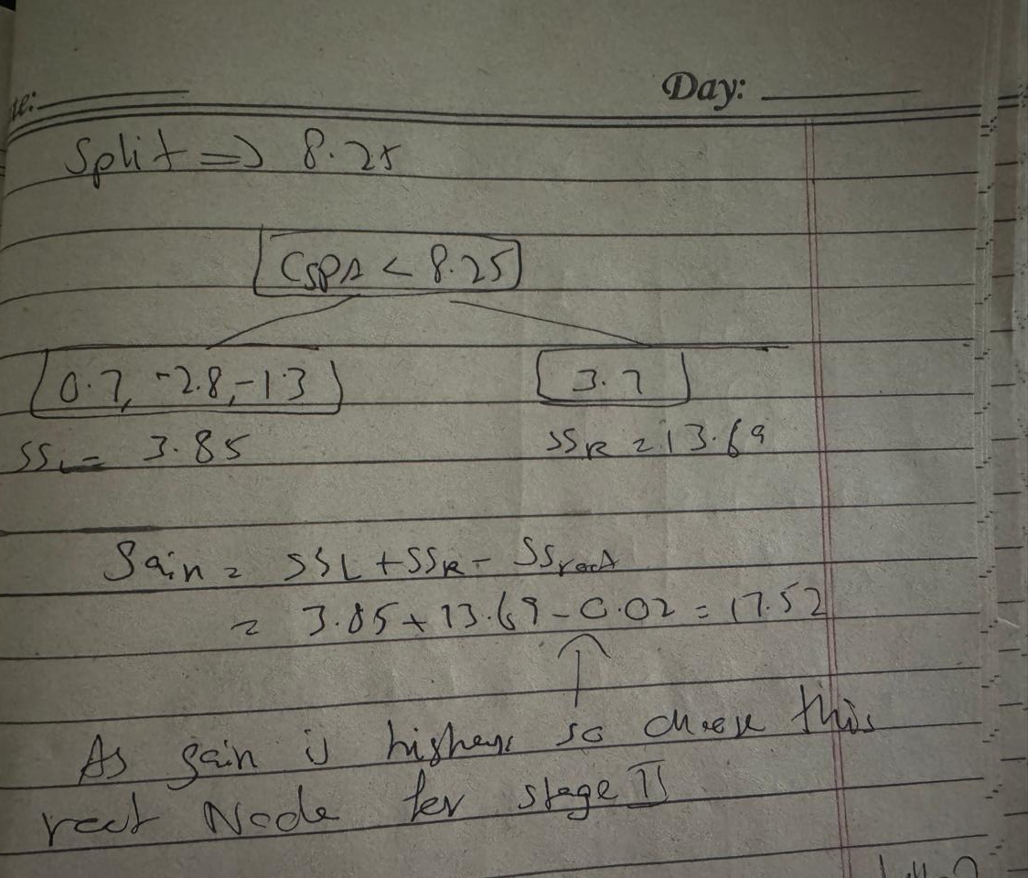
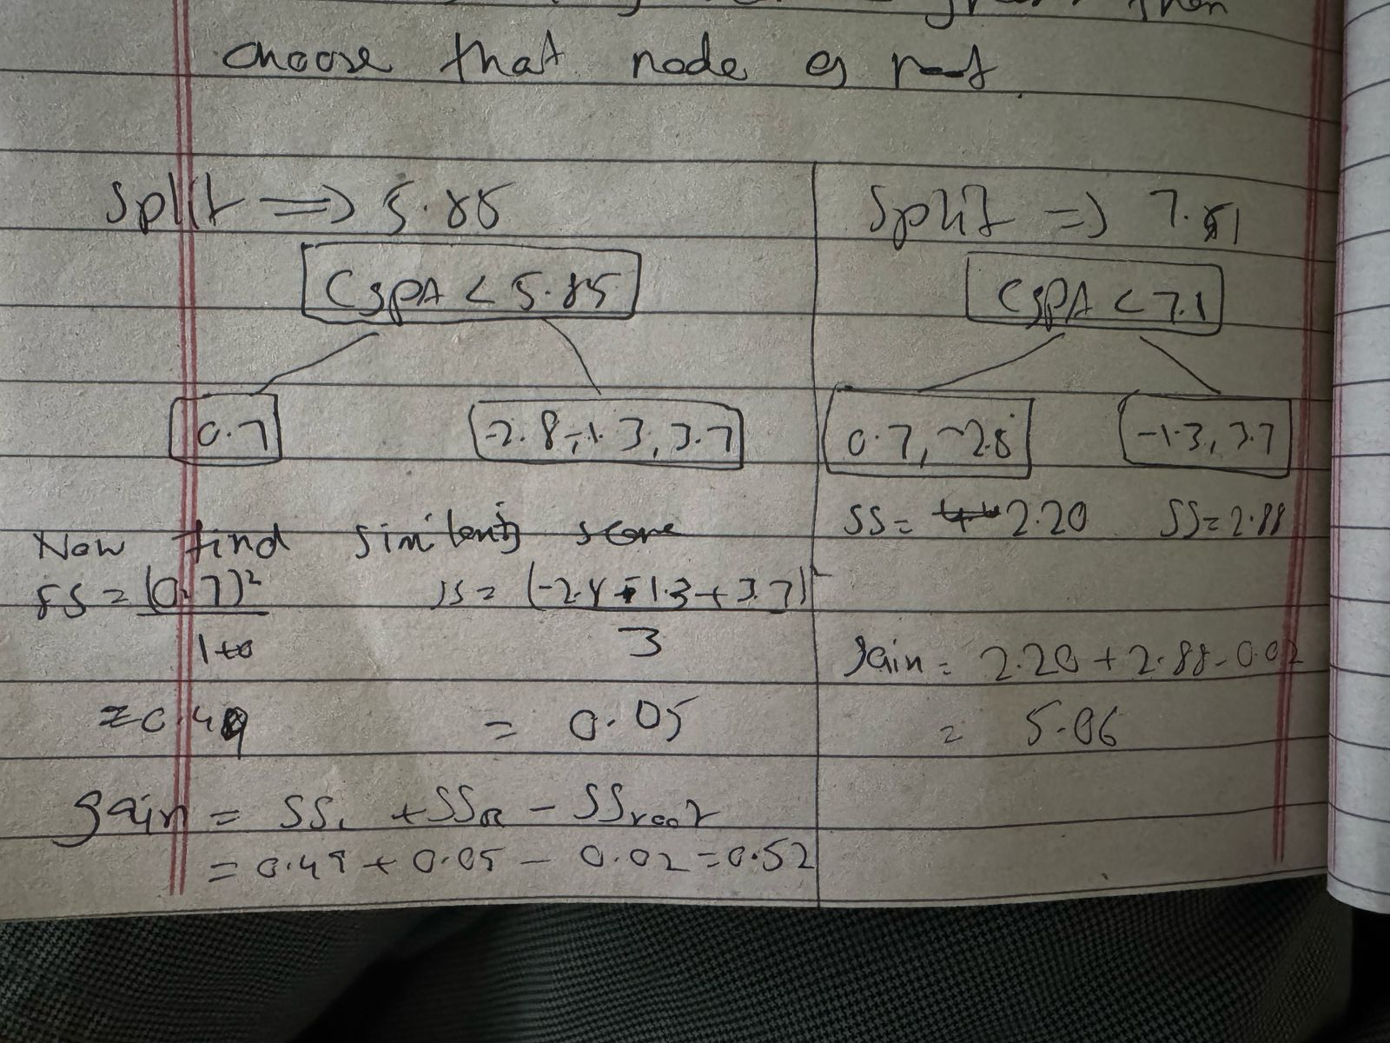
Split => 5.85 Split => 7.1
spli => 8.25

Slide 15
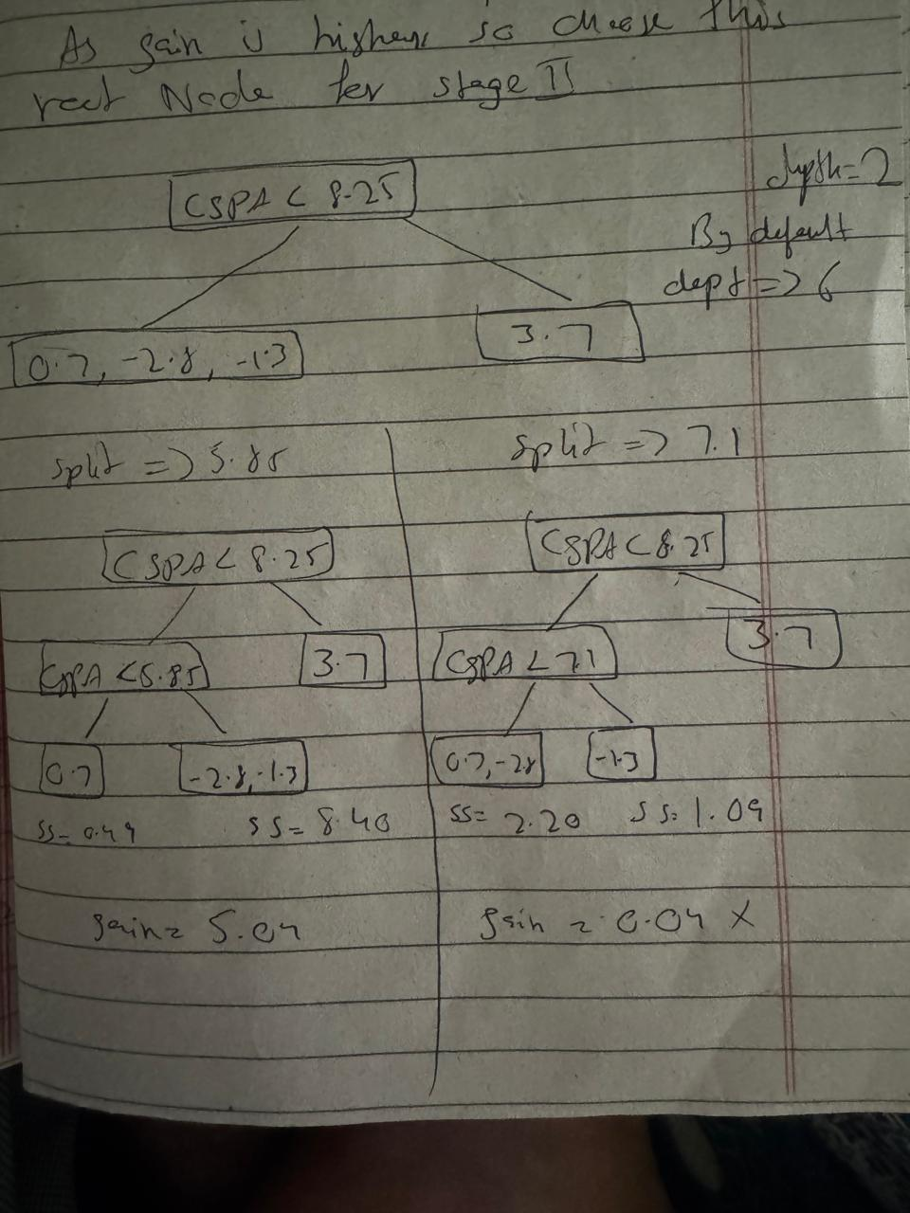
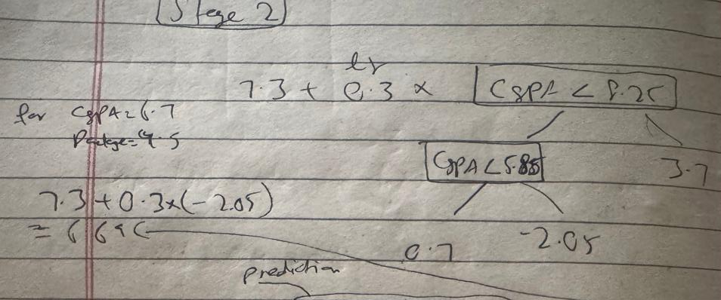
Now find output cvalues for leaf node output_value=sum of residual/# of residual+ lambda
stage 2 completed model will be:

Slide 16
GPA Package Model 1 Residual 1 Model 2 Residual 2
6.7 4.5 7.3 -2.8 6.69 -2.16
9.0 11 7.3 3.7 8.41 2.59
7.5 6 7.3 -1.3 6.69 -0.67
5.0 8 7.3 0.7 7.51 0.49
similarly do the same for stage 3 and so on
model of stage 3 will be:
model1+lr*dt2+lr*dt3

Slide 17
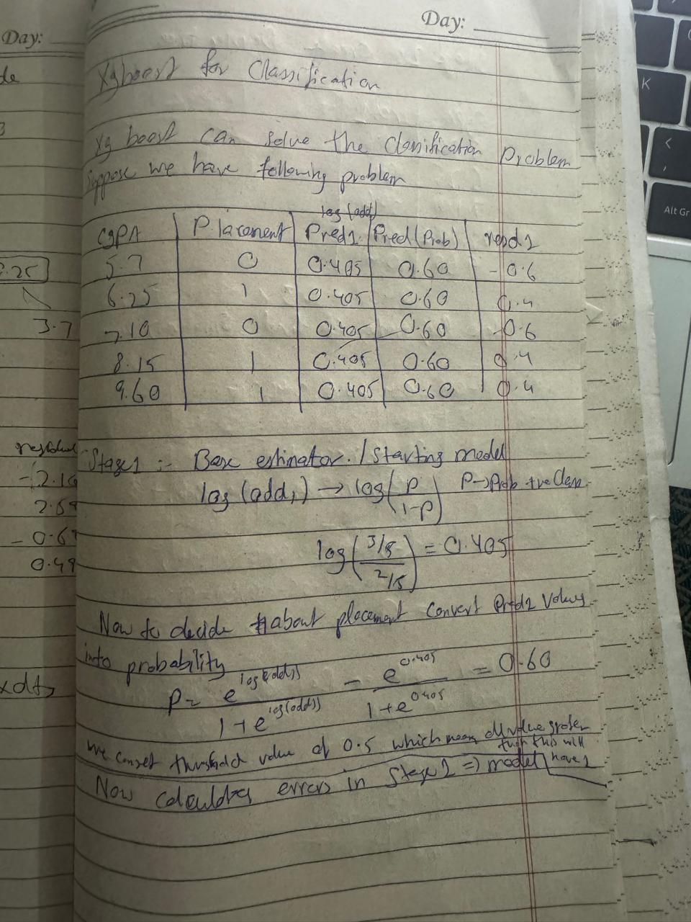
XG boost - Classification

Slide 18
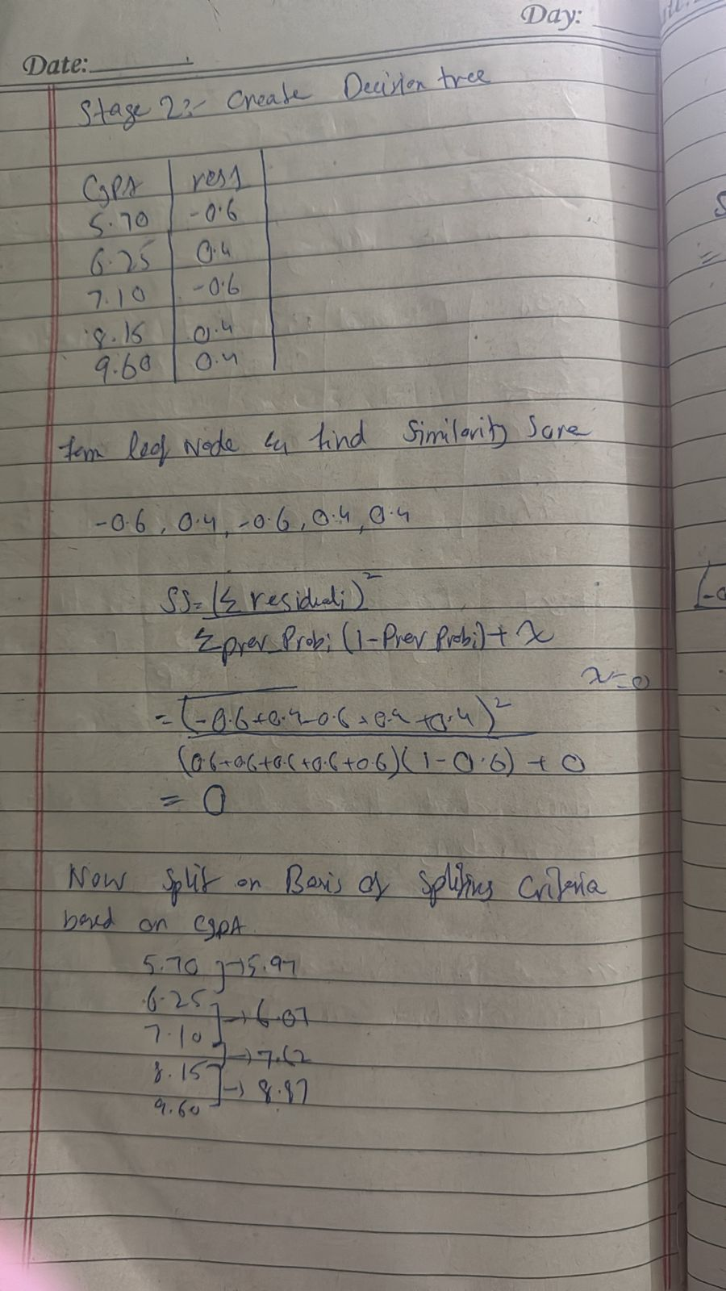

Slide 19
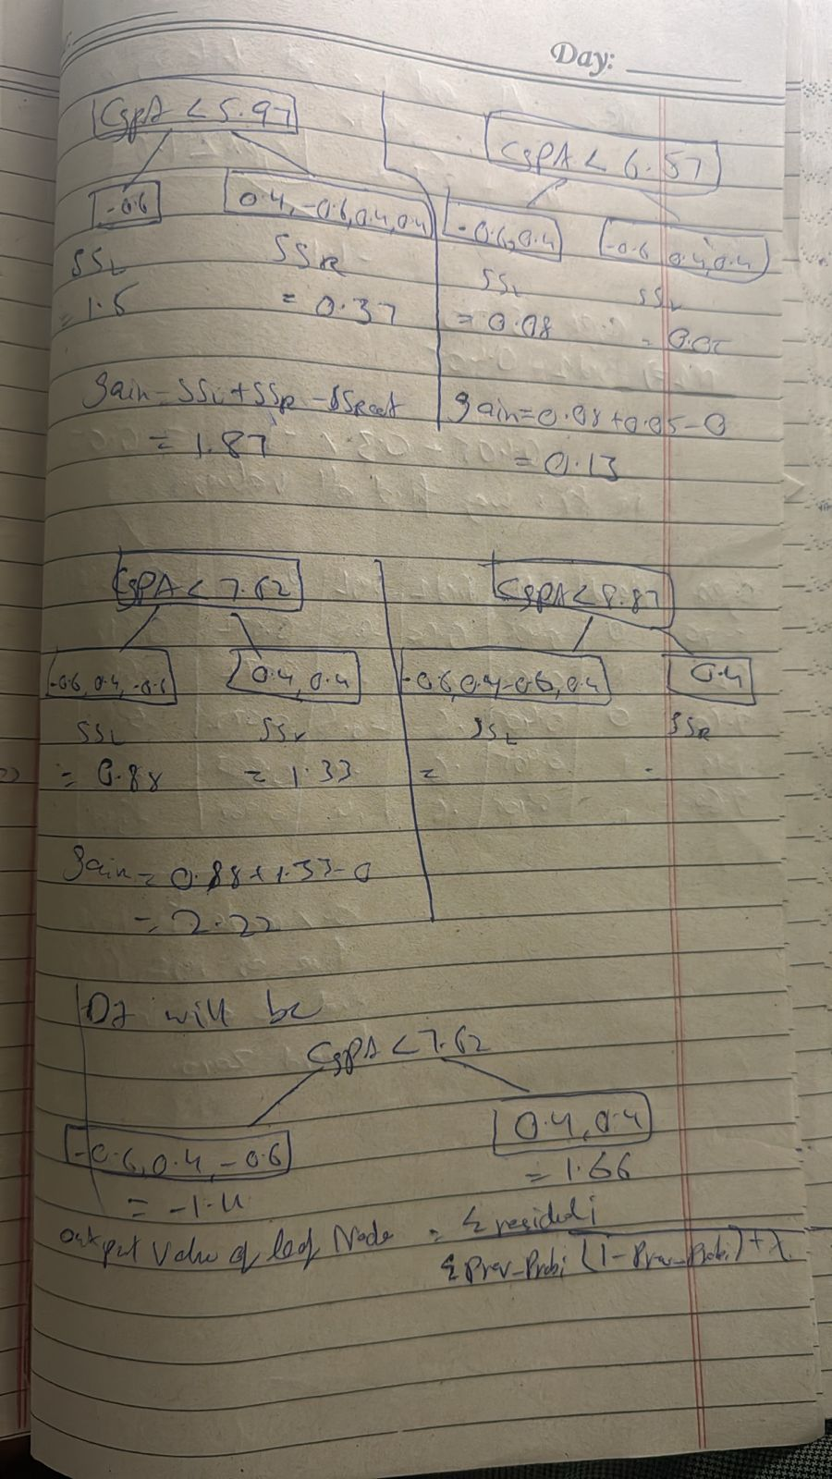

Slide 20
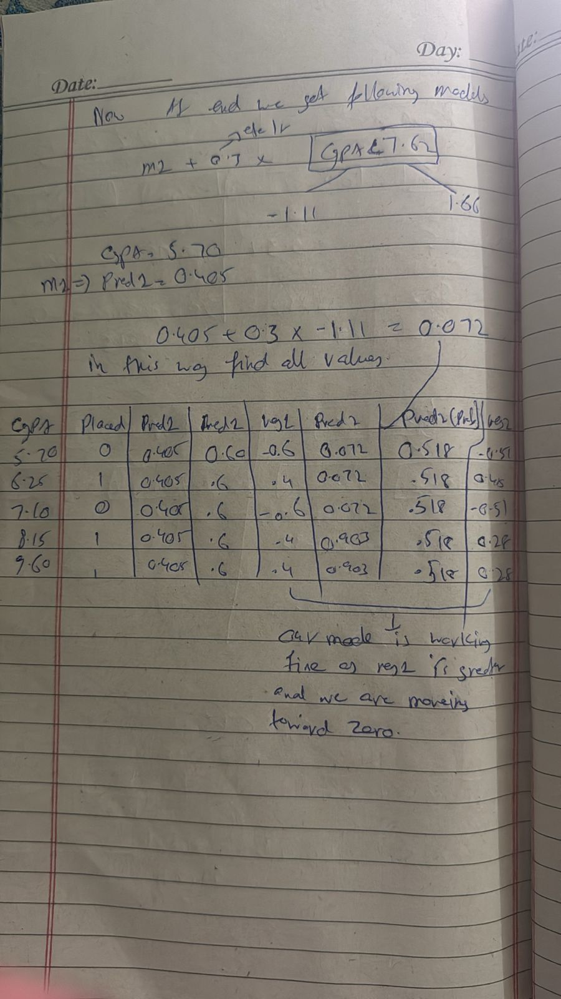

Slide 21
python code:
import numpy as np
from xgboost import XGBClassifier
# Original data: [CGPA, IQ]
original_X = np.array([
[3, 7],
[2, 9],
[1, 4],
[9, 8]
])

Slide 22
# Remove IQ column → only use CGPA
X = original_X[:, [0]] # selecting only the first column (CGPA)
y = np.array([1, 0, 0, 1])
# XGBoost model
model = XGBClassifier(eval_metric='logloss')
model.fit(X, y)
# Prediction with CGPA only (example: CGPA = 3)
prediction = model.predict([[9]])
print("Predicted Placement:", prediction[0])

